Slide 1

Psychopathology

Slide 2
Psychological Disorder
•How should we draw the line between normality and disorder?
•Psychological disorder is deviant, distressful, and dysfunctional patterns of thoughts, feelings, and actions.
•A mental disorder is a syndrome characterized by clinically significant disturbance in an individual's cognition, emotion regulation, or behavior that reflects a dysfunction in the psychological, biological, or development processes underlying mental functioning. (DSM-5)

Slide 3
Perspectives of Psychological Disorders
•What perspectives can help us understand psychological disorders?
•During the Middle Ages, you might have said “The devil made him do it,” and you might have approved of an exorcism to get rid of the evil demon.
Until the last two centuries, “mad” people were sometimes caged in zoo like conditions or given “therapies” appropriate to a demon: beatings, burning, or castration. In other times, therapy included trephination (drilling holes in the skull), pulling teeth, removing lengths of intestines, cauterizing the clitoris, or giving transfusions of animal blood (Farina, 1982).

Slide 4
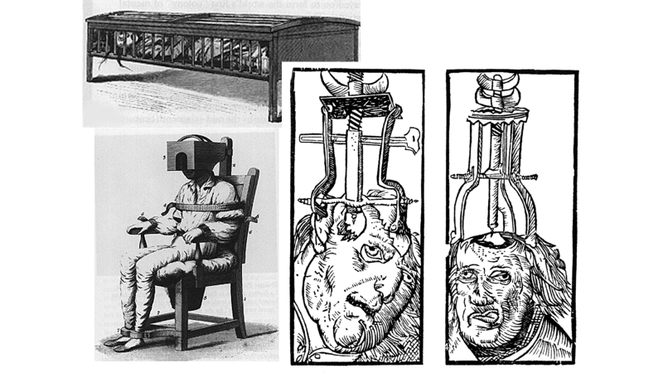

Slide 5


Slide 6
Perspectives of Psychological Disorders
Medical model
By the 1800s, the discovery that syphilis infects the brain and distorts the mind provided the impetus for further reform. Hospitals replaced asylums, and the medical world began searching for physical causes of mental disorders, and for treatments that would cure them.
Today, this medical model is recognizable in the terminology of the mental health movement: A mental illness (also called a psychopathology) needs to be diagnosed on the basis of its symptoms and cured through therapy, which may include treatment in a psychiatric hospital.

Slide 7
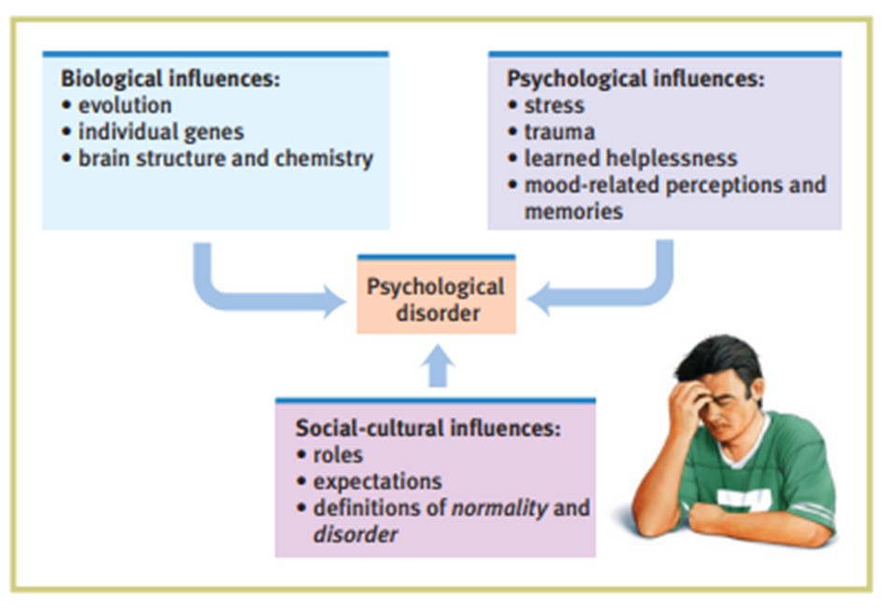
Perspectives of Psychological Disorders-Biopsychosocial model

Slide 8

Classification of Psychopathology
1.Neurodevelopmental disorders
2.Schizophrenia spectrum and other psychotic disorders
3.Bipolar and related disorders
4.Depressive disorders
5.Anxiety disorders
6.Obsessive-compulsive and related disorders
7.Trauma- and stressor-related disorders
8.Dissociative disorders
9.Somatic symptom and related disorders
10.Feeding and eating disorders

Slide 9
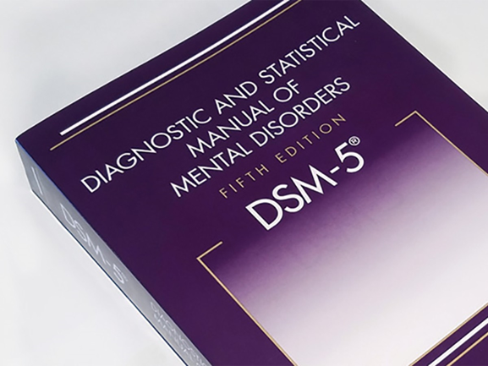
Classification of Psychopathology
11.Elimination disorders
12.Sleep-wake disorders
13.Sexual dysfunctions
14.Gender dysphoria
15.Disruptive, impulse-control, and conduct disorders
16.Substance-related and addictive disorders
17.Neurocognitive disorders
18.Personality disorders
19.Paraphilic disorders
20.Other mental disorders

Slide 10
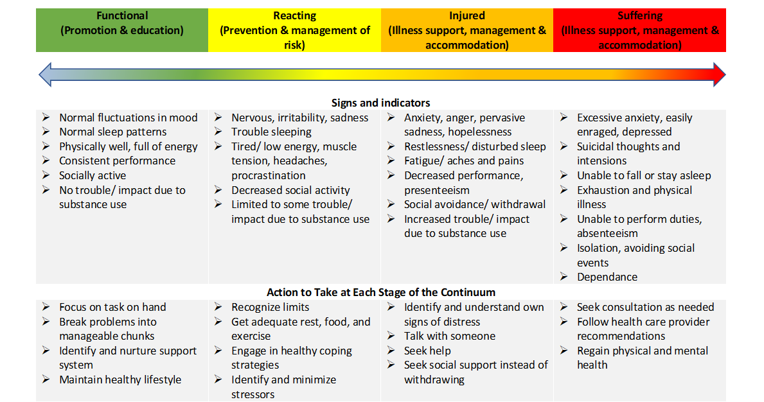
Mental Health Continuum Model

Slide 11
Prevention
Primary Prevention
Primary prevention focuses on the prevention of mental health disorders in the community before they occur. This level of prevention aims to decrease risk factors and increase protective factors in order to prevent a mental health disorder from occurring in the first place.
Examples of primary prevention activities include youth groups and clubs, which help to increase community bonds and support; parenting workshops

Slide 12
Prevention
Secondary Prevention
Secondary prevention focuses on the early detection and prompt intervention of mental health disorders. At this level of prevention, a patient already has a mental health disorder, and secondary prevention is aimed at detecting the disorder early in order to intervene promptly.
Essentially, this means screening. Screening patients for depression or suicide risk, for example, can lead to the early intervention ― and prevention — of a more dire outcome.
Tertiary Prevention
Tertiary prevention focuses on the period after a mental health disorder or crisis has already occurred. The focus at this point is to help promote the patient's recovery as well as to prevent further complications.
Source- https://leveluprn.com/blogs/psychiatric-mental-health/principles-12-primary-secondary-tertiary-prevention#:~:text=Primary%20prevention%20focuses%20on%20the,occurring%20in%20the%20first%20place.

Slide 13
Treatment
•Psychopharmacology
Medicines provided by psychiatrists
•Counseling
Professional assistance in coping with personal problems, including emotional, behavioral, vocational, marital, educational, rehabilitation, and life-stage problems. (APA)
•Psychotherapy
Psychotherapy is a type of treatment that can help individuals experiencing a wide array of mental health conditions and emotional challenges. Psychotherapy can help not only alleviate symptoms, but also, certain types of psychotherapies can help identify the psychological root causes of one’s condition so a person can function better and have enhanced emotional well-being and healing. (APA)

Slide 14
Mental Health Services Available in Bangladesh
•Counseling and Wellness Centre (BRAC University)
•Counseling service (Educational and Counseling Psychology Department, University of Dhaka)
•Nasirullah Psychotherapy Unit (Clinical Psychology Department, University of Dhaka)
•Psychiatry Unit, Govt Hospital (e.g. BSMMU, Dhaka Medical College and Hospital)
•National Institute of Mental Health
•Different private hospital and organization

Slide 15
Careers in Psychology

